Slide 1

Project Title -Seasonal Agriculture Performance Analysis
[Student Name – Krishna Kheria
College Name- NIMS University]
AICTE STU ID : STU6a5fa3e5b45fa1784652773

Slide 2

PROBLEM STATEMENT
Agricultural activities are influenced by seasonal variations in environmental conditions,farming practices, resource availability and market conditions. As a result, agricultural performance may differ from one season to another.However, raw agricultural data does not clearly explain how agricultural performance changesacross seasons or what patterns can be observed in different seasonal conditions.The problem is to analyze the given agricultural dataset and investigate seasonal differences in agricultural performance by identifying meaningful patterns, trends, relationships and variations within the available data.

Slide 3
PROJECT DESCRIPTION
This project analyzes agricultural data across different seasons to identify patterns, trends, and variations in agricultural performance. The analysis covers crop yield, production, environmental conditions, resource usage, irrigation methods, water efficiency, costs, revenue, profitability, and disease/pest risk.
Using Python, Pandas, Matplotlib, Seaborn, and SciPy, the project performs data cleaning, exploratory data analysis, statistical analysis, correlation analysis, and visualization. The results are used to compare agricultural performance across seasons and derive data-driven insights and recommendations for better seasonal agricultural planning.

Slide 4

WHO ARE THE END USERS?
Farmers, agricultural planners, government agricultural departments, researchers, agribusinesses, and resource/irrigation managers who can use seasonal agricultural insights for better planning and decision-making.

Slide 5

Technology Used
Python, Jupyter Notebook, Pandas, NumPy, Matplotlib, Seaborn, and SciPy.

Slide 6
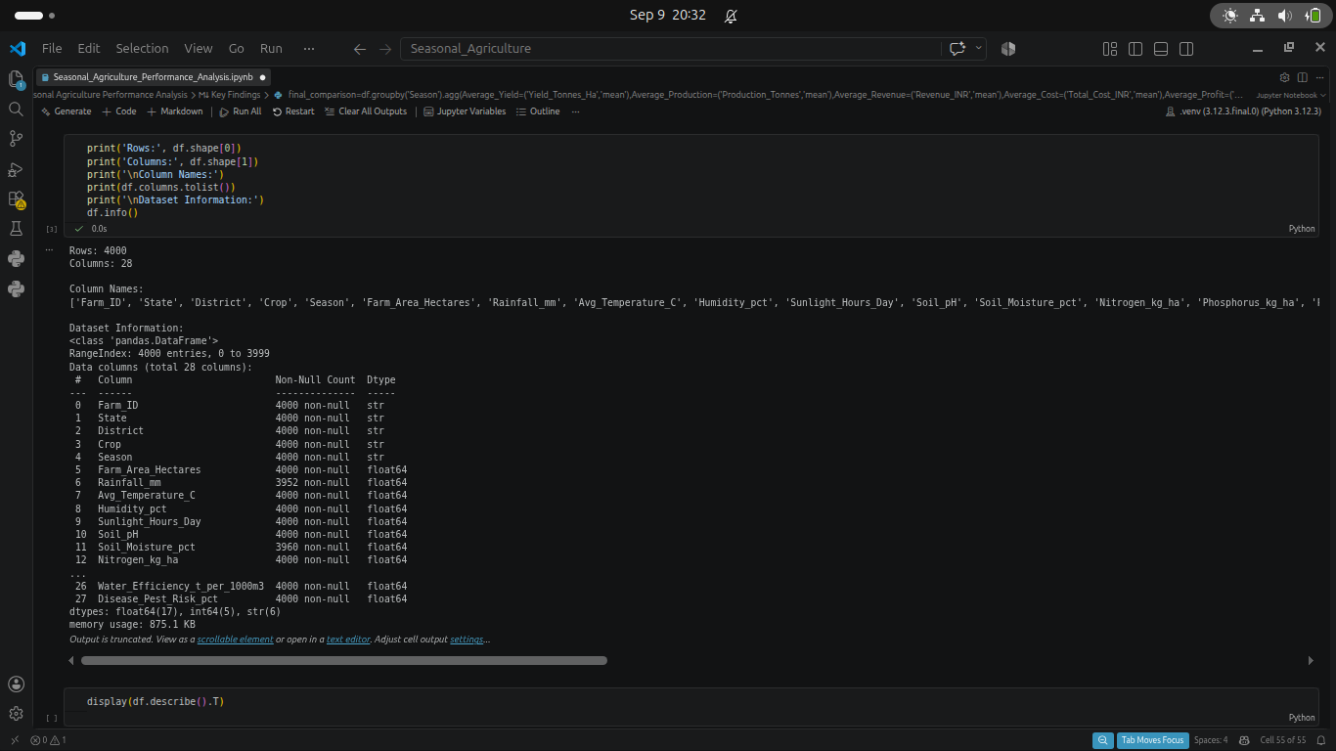
RESULTS

Slide 7
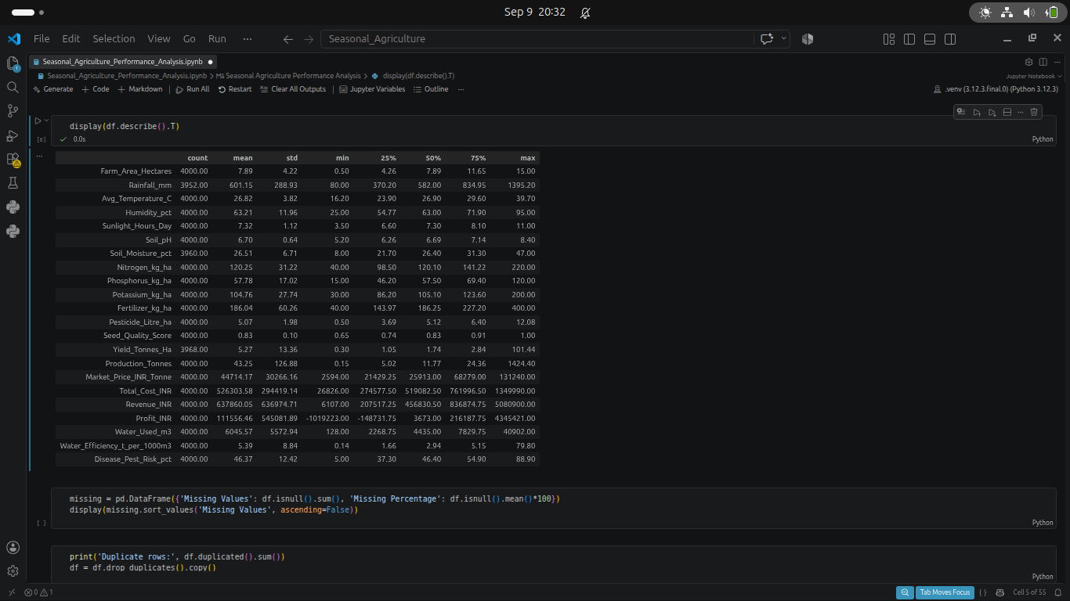
RESULTS
[Add screen shots of your code ]

Slide 8
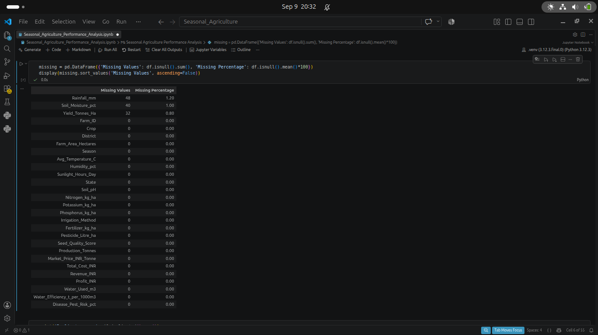
RESULTS
[Add screen shots of your code ]

Slide 9
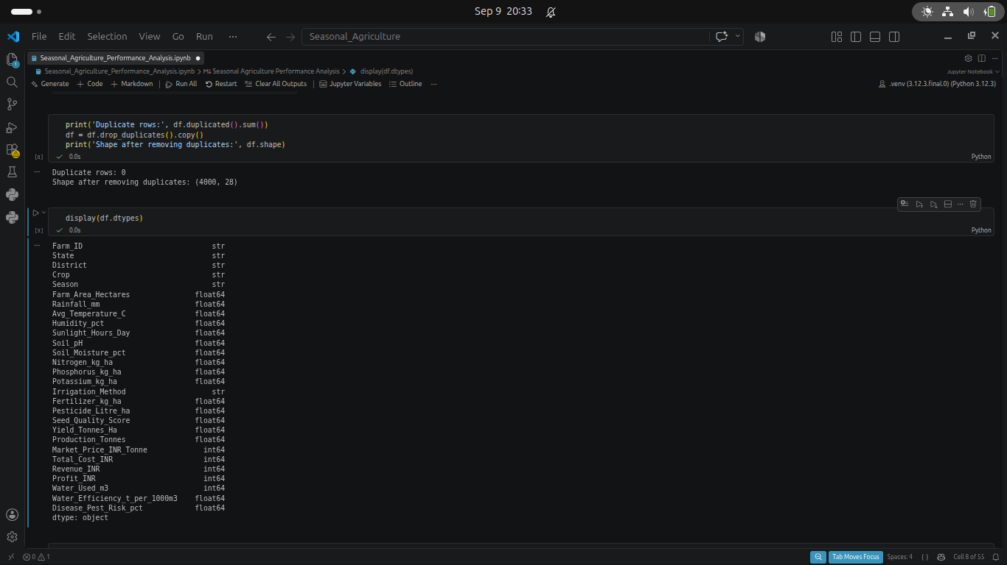
RESULTS
[Add screen shots of your code ]

Slide 10
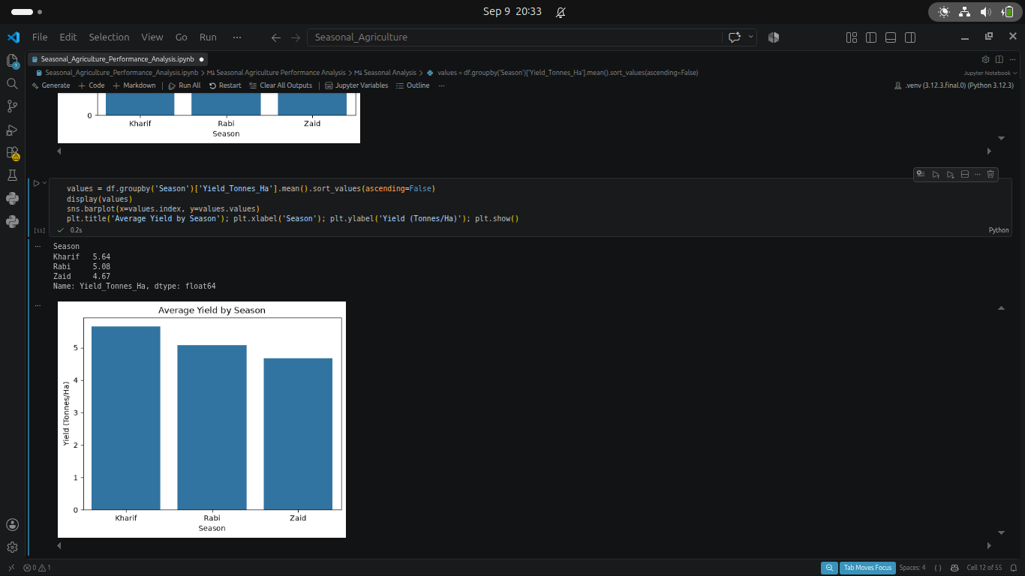
RESULTS
[Add screen shots of your code ]

Slide 11
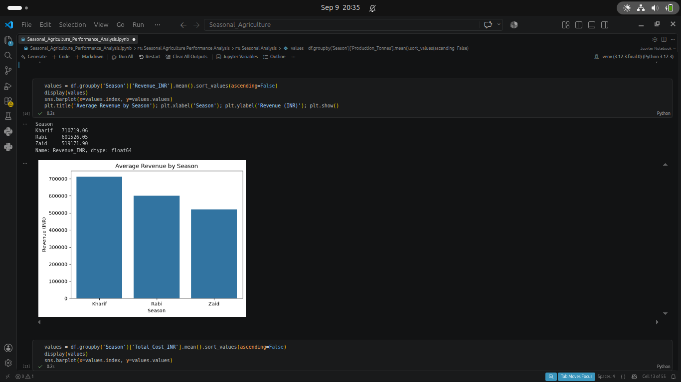
RESULTS
[Add screen shots of your code ]

Slide 12
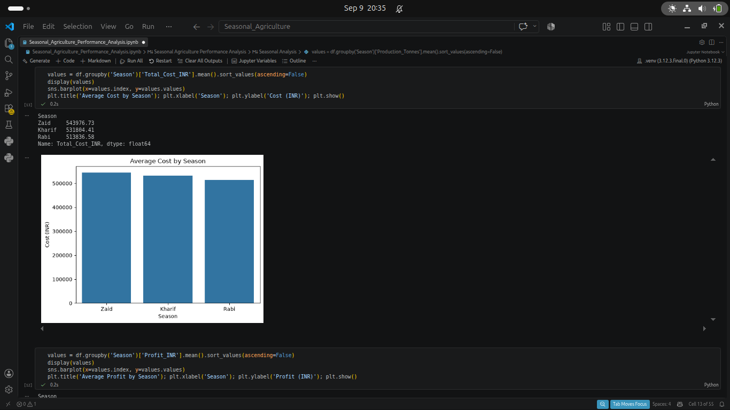
RESULTS
[Add screen shots of your code ]

Slide 13
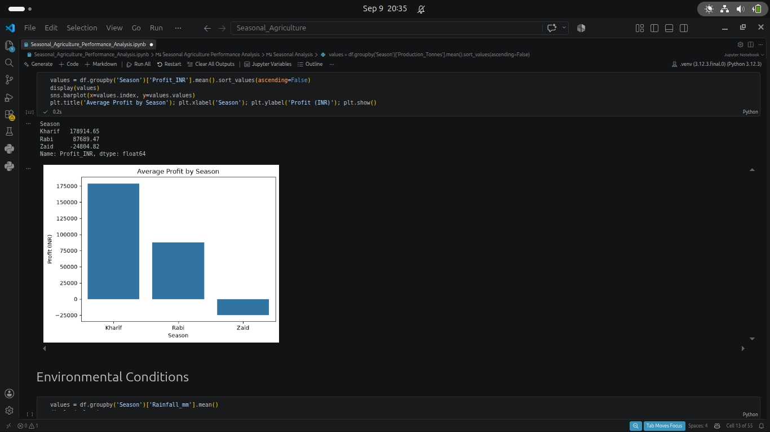
RESULTS
[Add screen shots of your code ]

Slide 14
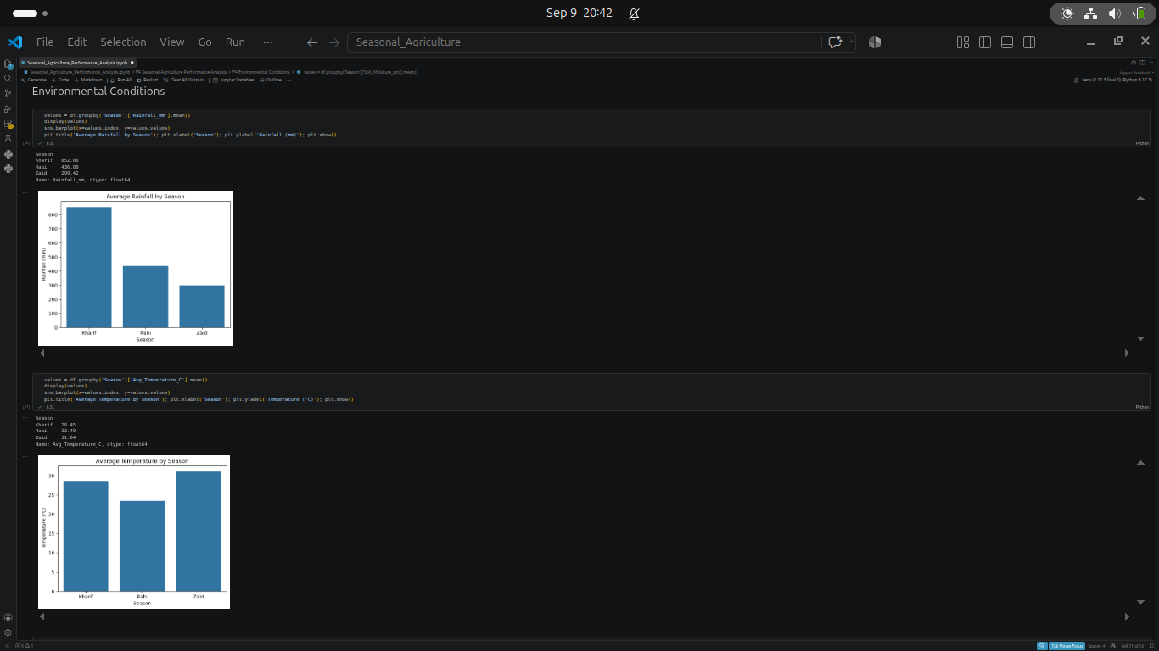
RESULTS
[Add screen shots of your code ]

Slide 15
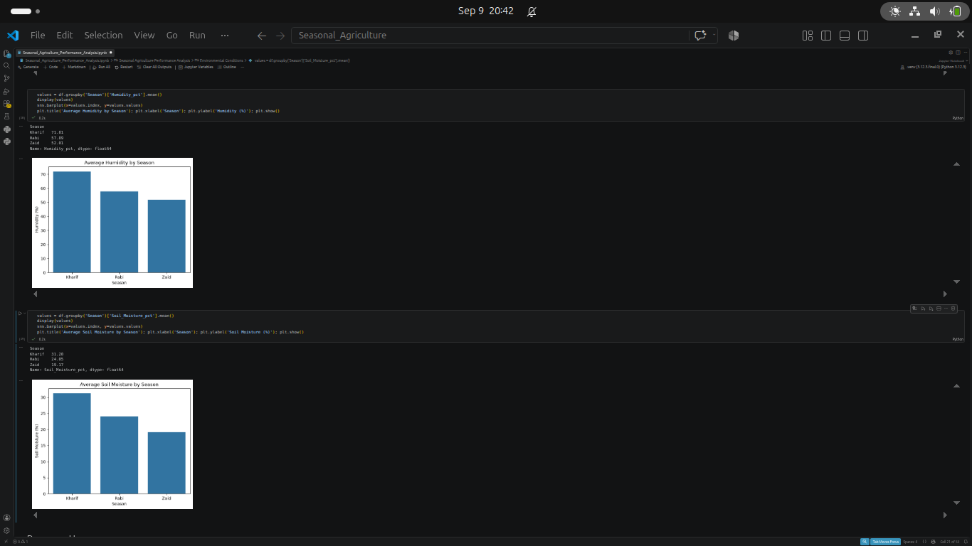
RESULTS
[Add screen shots of your code ]

Slide 16
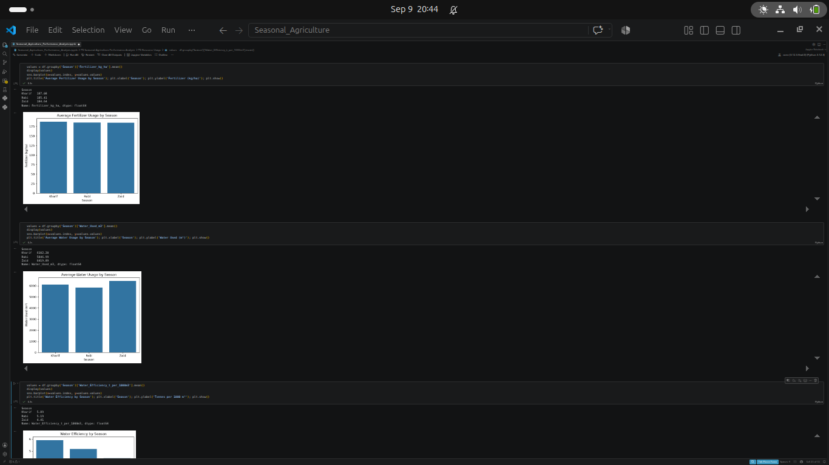
RESULTS
[Add screen shots of your code ]

Slide 17
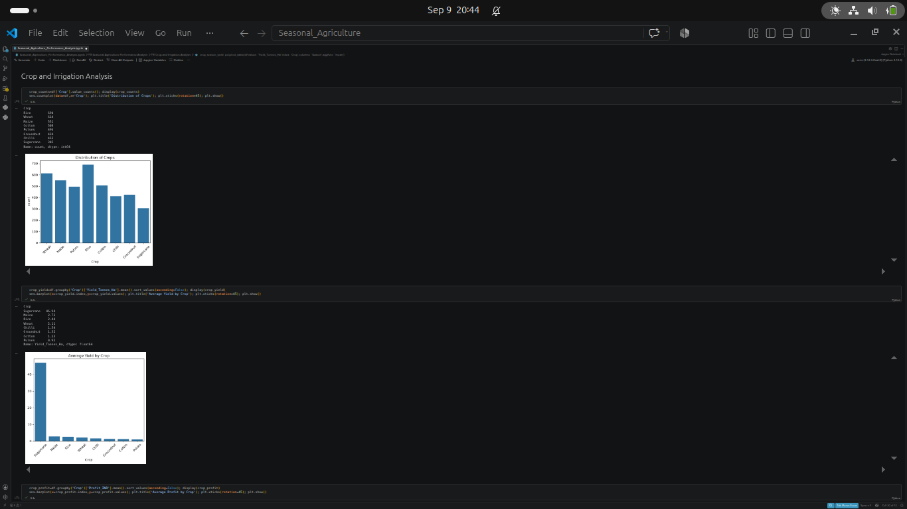
RESULTS
[Add screen shots of your code ]

Slide 18
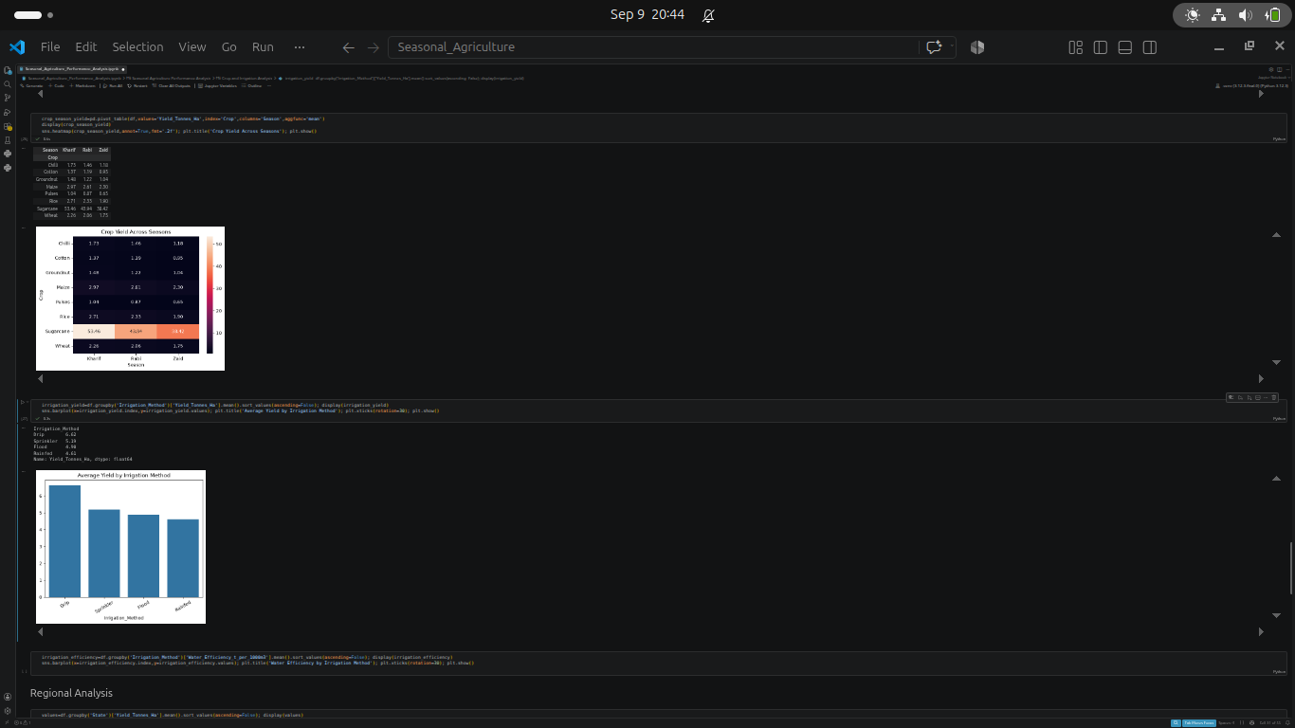
RESULTS
[Add screen shots of your code ]

Slide 19
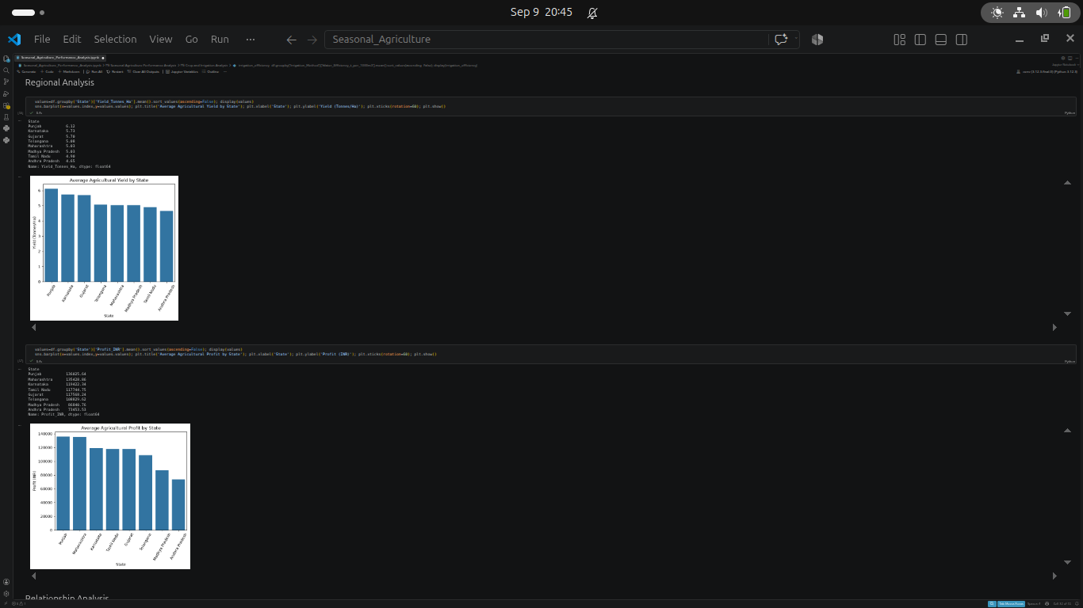
RESULTS
[Add screen shots of your code ]

Slide 20
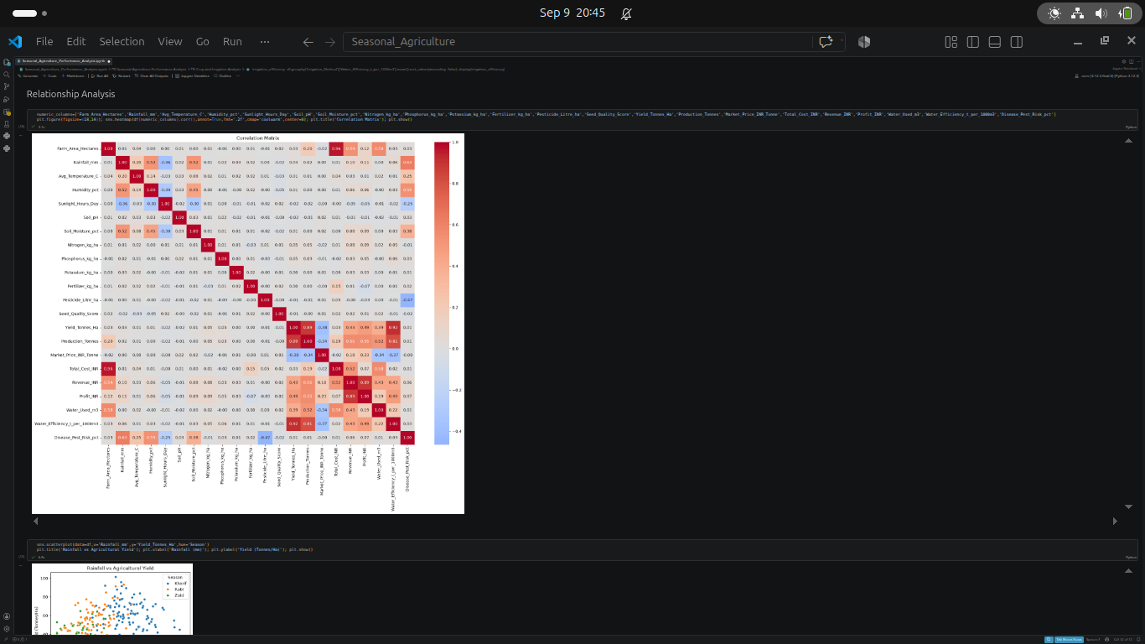
RESULTS
[Add screen shots of your code ]

Slide 21
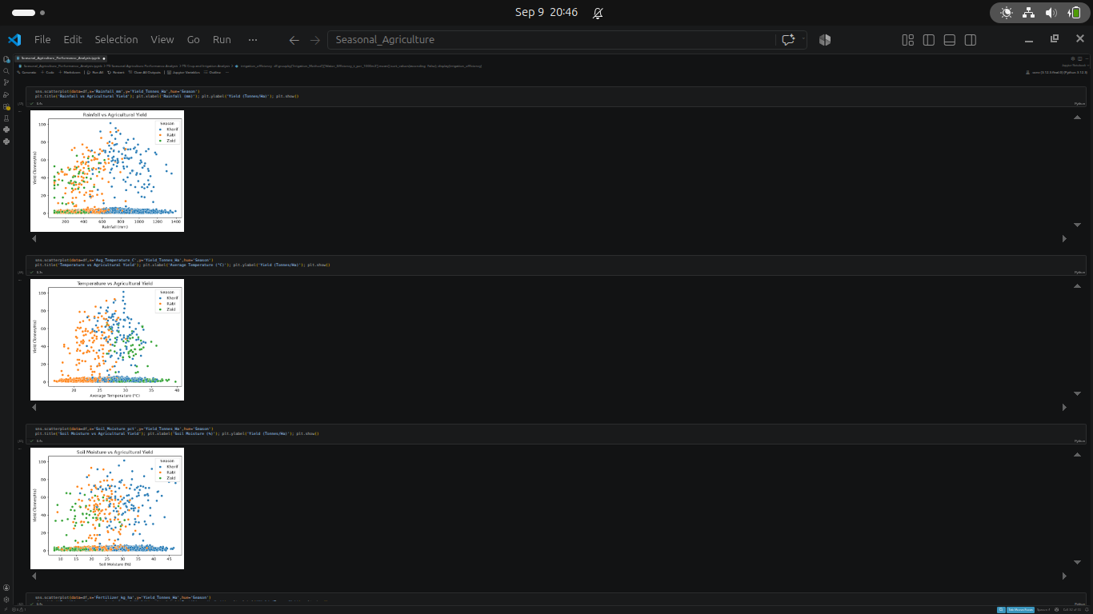
RESULTS
[Add screen shots of your code ]

Slide 22
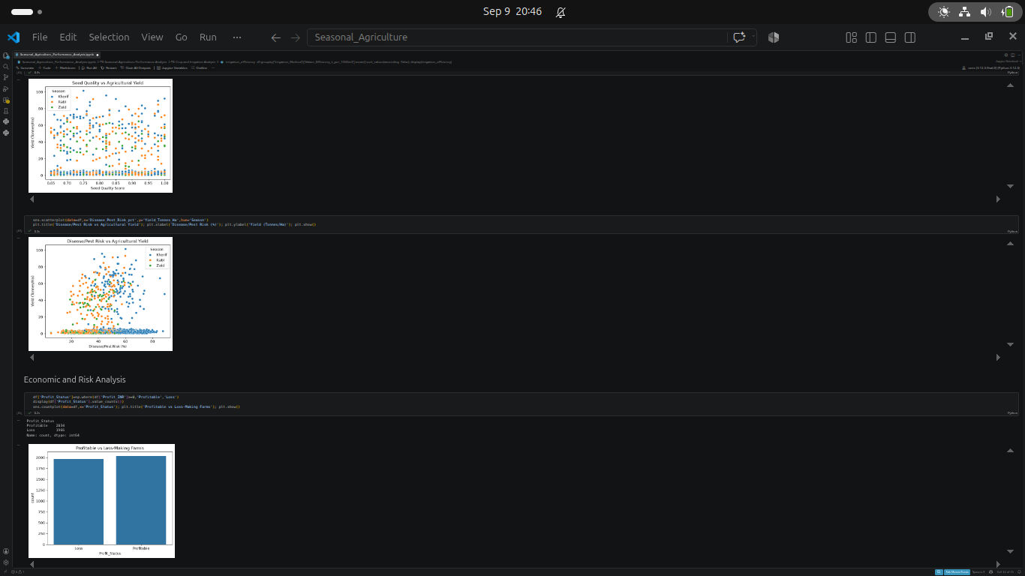
RESULTS
[Add screen shots of your code ]

Slide 23
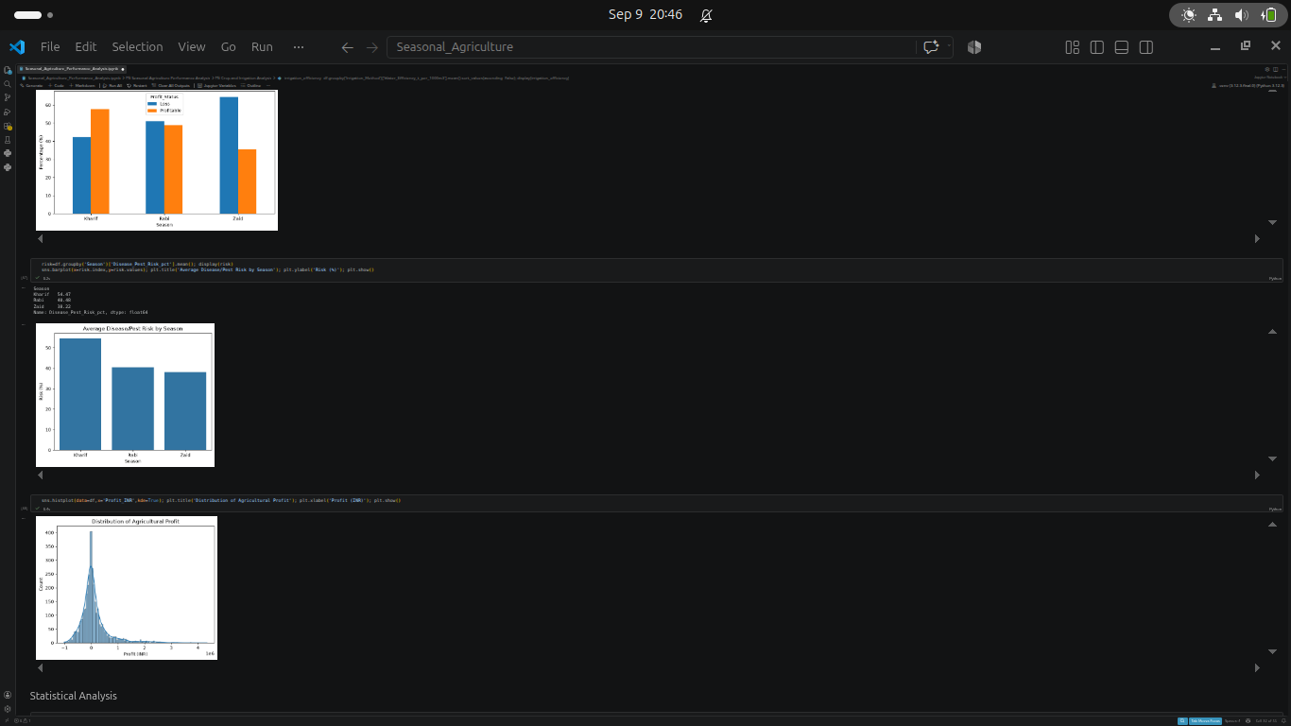
RESULTS
[Add screen shots of your code ]

Slide 24
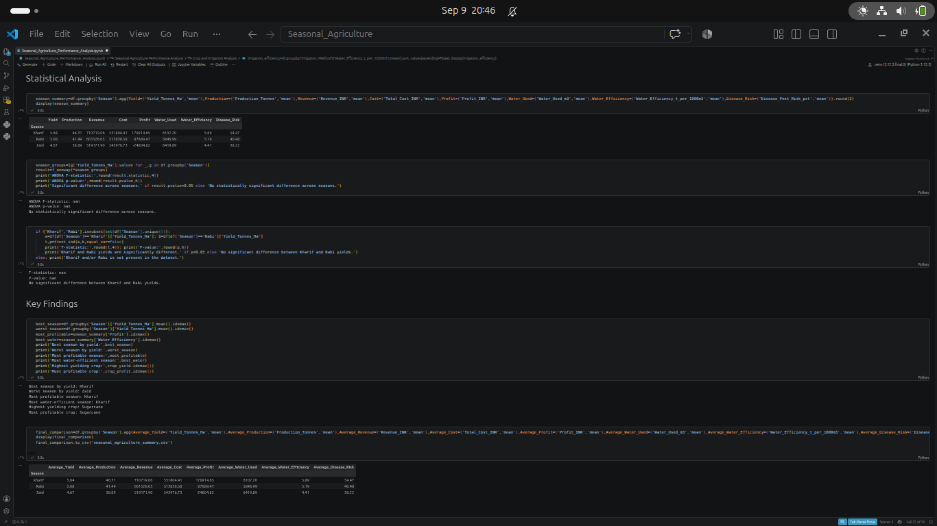
RESULTS
[Add screen shots of your code ]

Slide 25
Future scope
The project can be extended by integrating Machine Learning for yield and profit prediction, real-time weather data, smart irrigation recommendations, crop and disease prediction, and interactive dashboards for real-time agricultural decision-making.

Slide 26
GitHub Link
https://github.com/kkheria5-hash/seasonal-agriculture-performance.git

Slide 27
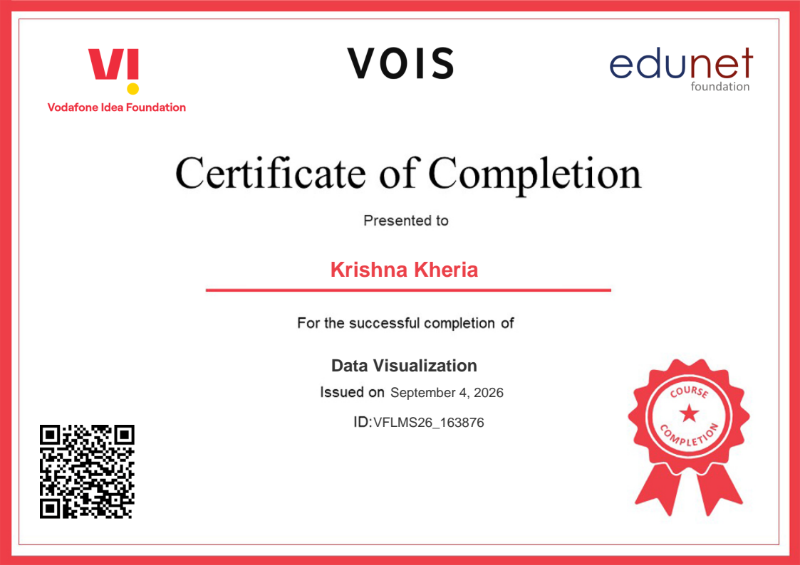
VOIS Course completion certificate - Course name- Data Visualization

Slide 28
Thank you
.
.

